Slide 1

A gamified introduction to Python Programming Lecture 3 None, pass, Booleans and functions
Matthieu DE MARI – Singapore University of Technology and Design

Slide 2

Outline (Chapter 3)
What are the None type and the pass keyword?
What is the Boolean type?
Boolean quiz for practice.
Advanced concepts on Booleans.
What are functions in Python and how to use them?
What are memory states in functions?

Slide 3
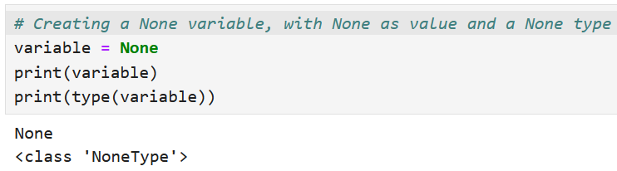
The None type
Definition (the None type): You can define a variable with an empty value by assigning a None value to a variable. This is used to indicate that a variable exists in memory even though no value has yet been assigned to it.
Used in some activities to “hint” on some variables, functions or structures you should be using but should probably be replaced with something else!

Slide 4
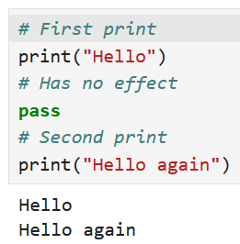
The pass keyword
Definition (the pass keyword): Similarly, you can use the pass keyword, which is equivalent to “doing nothing”. It simply has no effect on the code.
Used in some activities to “hint” on some variables, functions or structures you should be using but should probably be replaced with something else!

Slide 5
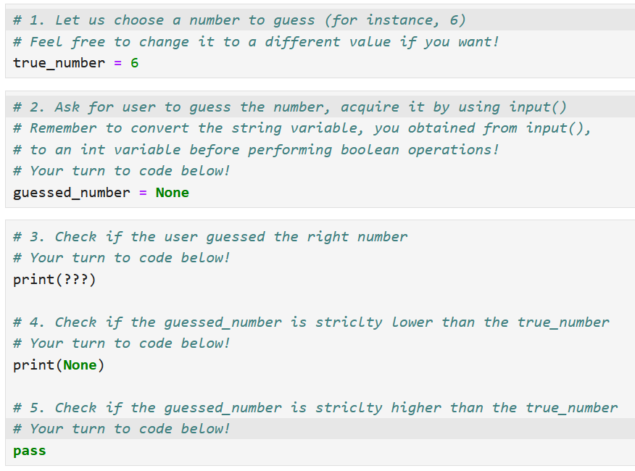
The pass keyword
Definition (the pass keyword): Similarly, you can use the pass keyword, which is equivalent to “doing nothing”. It simply has no effect on the code.
Used in some activities to “hint” on some variables, functions or structures you should be using but should probably be replaced with something else!

Slide 6
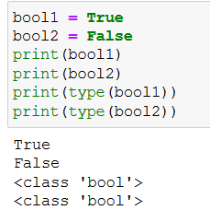
The boolean type
Definition (the boolean type): The boolean (bool) type is an essential type in programming.
In simple terms, it is the answer to a yes or no question.
It is commonly used to check if a condition is satisfied or not.
It can only take two values:
True, if the condition is satisfied;
or False, otherwise.

Slide 7
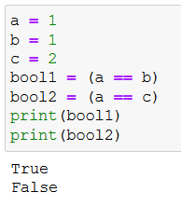
Boolean comparisons
Definition (the == operator):
The == operator is used to check if the two variables, on both sides of the == sign, have identical values.
The result of this operation is a Boolean variable, with value:
True, if both variables have identical values;
and False, otherwise.

Slide 8
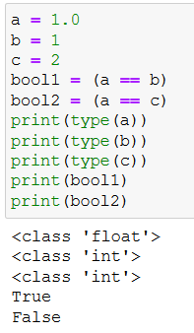
Boolean comparisons
Important note: Almost always, it returns False, by default, if both variables have different types.
One of the few exceptions to this rule is that it works if variables have mixed int/float types.
In that case, the numerical value is being compared.

Slide 9
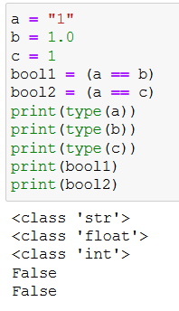
Boolean comparisons
Important note: Almost always, it returns False, by default, if both variables have different types.
One of the few exceptions to this rule is that it works if variables have mixed int/float types.
In that case, the numerical value is being compared.
But not with str and int/float!

Slide 10
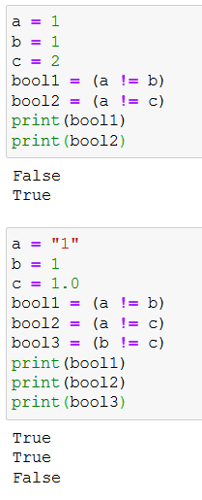
Boolean comparisons
Following the same logic as the == operator, we can define, the following operators, for numerical types (int/float).
!=: to check if two variables are different.
Note: Again, careful with the types on both sides! Let us only use these operators with similar types on both sides!

Slide 11
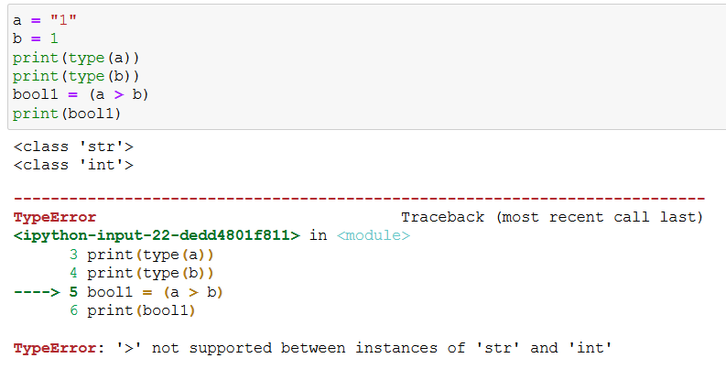
Boolean comparisons
Similarly,
>: if variable on the left-hand side has a strictly higher numerical value, than the one on the right-hand side.
<: same as >, but checking for strictly lower numerical value.
Note: again, careful with the types on both sides! Let us only use these operators with similar types on both sides!

Slide 12
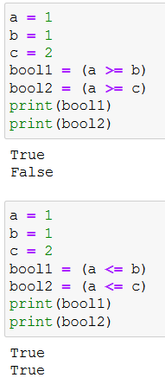
Boolean comparisons
Similarly,
>=: if variable on the left-hand side has a higher or equal numerical value, than the one on the right-hand side.
<=: same as >=, but checking for lower or equal numerical value.
Note: again, careful with the types on both sides! Let us only use these operators with similar types on both sides!

Slide 13
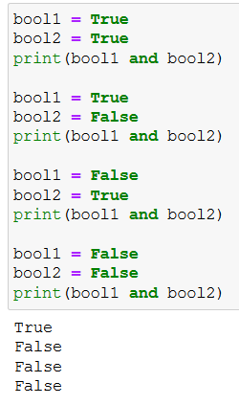
Boolean combinations: and, or, not
Definition (the and operator):
The and operator returns a boolean with value True, if and only if both Boolean variables on the left- and right-hand sides of the and operator are True.
It returns False otherwise.
Typically used to ask more advanced questions (e.g. voting rights if this person is at least 18yo and a Singaporean citizen?)

Slide 14
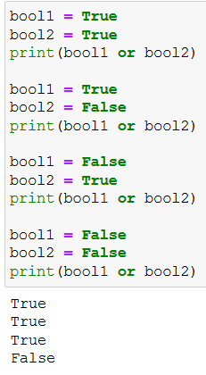
Boolean combinations: and, or, not
Definition (the or operator):
Similarly, the or operator returns a boolean with value True, if and only if at least one of the Boolean variables on the left- and right-hand sides of the or operator are True.
It returns False otherwise.
Again, typically used to ask more advanced questions.

Slide 15
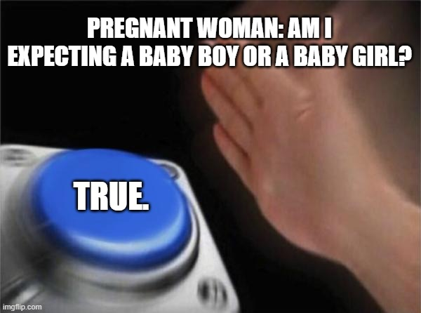

Boolean combinations: and, or, not
Definition (the or operator):
Similarly, the or operator returns a boolean with value True, if and only if at least one of the Boolean variables on the left- and right-hand sides of the or operator are True.
It returns False otherwise.
Again, typically used to ask more advanced questions.

Slide 16
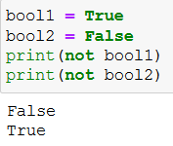
Boolean combinations: and, or, not
Definition (the not operator):
The not operator returns a boolean with opposite value.
If var is True, then not var is False;
And, if var is False, then not var is True.

Slide 17



Please download and install the Slido app on all computers you use
Assume that a, b and c are three int variables with respective values 6, 3 and 9. What will be displayed upon running the command print(a+b==c)?
ⓘ Start presenting to display the poll results on this slide.

Slide 18
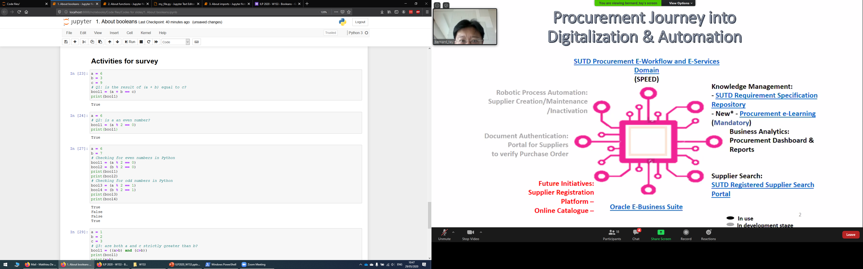
Boolean type: practice quiz! (answers)

Slide 19
Please download and install the Slido app on all computers you use
Assume that a is an int variable with value 6. What will be displayed upon running the command print(a%2==0)?
ⓘ Start presenting to display the poll results on this slide.

Slide 20
Boolean type: practice quiz! (answers)

Slide 21

Please download and install the Slido app on all computers you use
Which int values of the variable a will display True when running the command print(a%2==0)?
ⓘ Start presenting to display the poll results on this slide.

Slide 22
Boolean type: practice quiz! (answers)

Slide 23
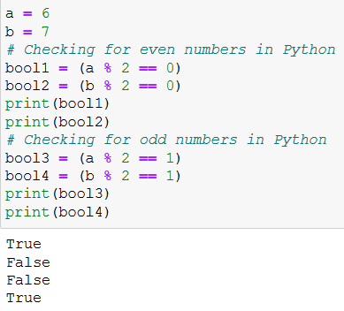
Boolean type: practice quiz! (answers)

Slide 24
Please download and install the Slido app on all computers you use
Assume that a, b and c are three int variables with respective values 1, 2 and 3. What will be displayed upon running the command print((a>b) and (c>b))?
ⓘ Start presenting to display the poll results on this slide.

Slide 25
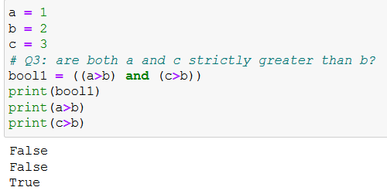
Boolean type: practice quiz! (answers)

Slide 26
Please download and install the Slido app on all computers you use
Assume that a, b, c and d are four int variables with respective values 1, 2, 3 and 4. What will be displayed upon running the (absolutely awful) command, below? print((not (a>=b) or (c<b)) and (d+3>=c*2))
ⓘ Start presenting to display the poll results on this slide.

Slide 27
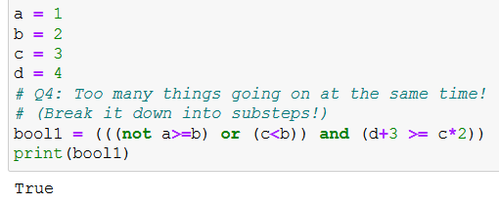
Boolean type: practice quiz! (answers)

Slide 28
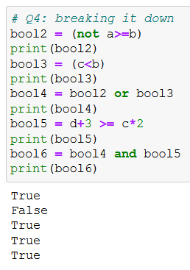
Boolean type: practice quiz! (answers)

Slide 29
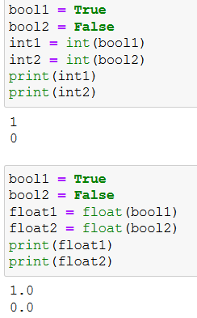
Boolean conversion
Bool → Int/Float: You can convert a Boolean into an int/float number.
True transforms into 1 (int) or 1.0 (float).
False transforms into 0 (int) or 0.0 (float).

Slide 30
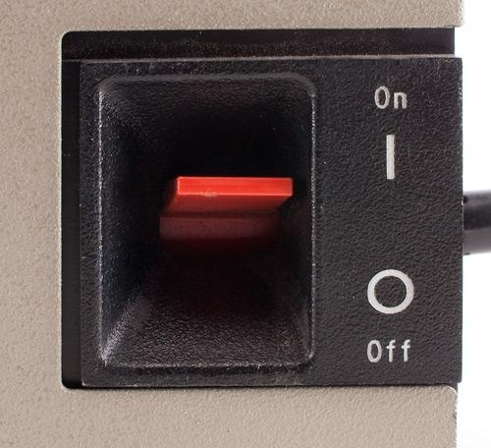
Boolean conversion
Bool → Int/Float: You can convert a Boolean into an int/float number.
True transforms into 1 (int) or 1.0 (float).
False transforms into 0 (int) or 0.0 (float).
Fun fact: that is reason behind the on/off symbols.
On/True/1
Off/False/0

Slide 31
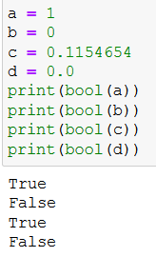
Boolean conversion
Int/Float → Bool: You can convert an int/float number into a boolean.
Any non-zero numerical value becomes True.
A zero numerical value becomes False.

Slide 32
Please download and install the Slido app on all computers you use
Assume that a, b and c are three int variables with values 1, 2 and 3 respectively. What will be displayed upon running the command print(a>b and c)?
ⓘ Start presenting to display the poll results on this slide.

Slide 33
Please download and install the Slido app on all computers you use
Assume that a, b and c are three int variables with values 1, 2 and 3 respectively. What will be displayed upon running the command print(a<b and c)? Note that the comparison sign has been changed compared to the previous question.
ⓘ Start presenting to display the poll results on this slide.

Slide 34
Short-circuit evaluation
Definition (Short-circuit evaluation):
Short-circuit evaluation in Python means that in boolean expressions using the “and” keyword and “or” keyword, the evaluation might stop prematurely.
For example, in the expression “a and b”, if a is False, b is not evaluated because the entire expression is guaranteed to be False.
Similarly, in “a or b”, if a is True, b is not evaluated because the entire expression is guaranteed to be True.
HOWEVER, in the expression “a and b”, if a is True, then the result of “a and b” will be exactly equal to whatever b is (True or False). Funny enough, if b is not a Boolean (but say an int with value 4 instead), then the whole expression “a and b” will be evaluated as 4 (wut !?!?).

Slide 35
Short-circuit evaluation
Definition (Short-circuit evaluation):
Short-circuit evaluation in Python means that in boolean expressions using the “and” keyword and “or” keyword, the evaluation might stop prematurely.
For example, in the expression “a and b”, if a is False, b is not evaluated because the entire expression is guaranteed to be False.
Similarly, in “a or b”, if a is True, b is not evaluated because the entire expression is guaranteed to be True.
Typical mistake: HOWEVER, in the expression “a and b”, if a is True, then the result of “a and b” will be exactly equal to whatever b is (True or False). Funny enough, if b is not a Boolean (but say an int with value 4 instead), then the whole expression “a and b” will be evaluated as 4 (wut !?!?).

Slide 36
Activity 1: Guess the number game!
Let us play a bit with the concepts, with a first activity
You can find it in the notebook Activity 1 - Guess the number game.ipynb

Slide 37
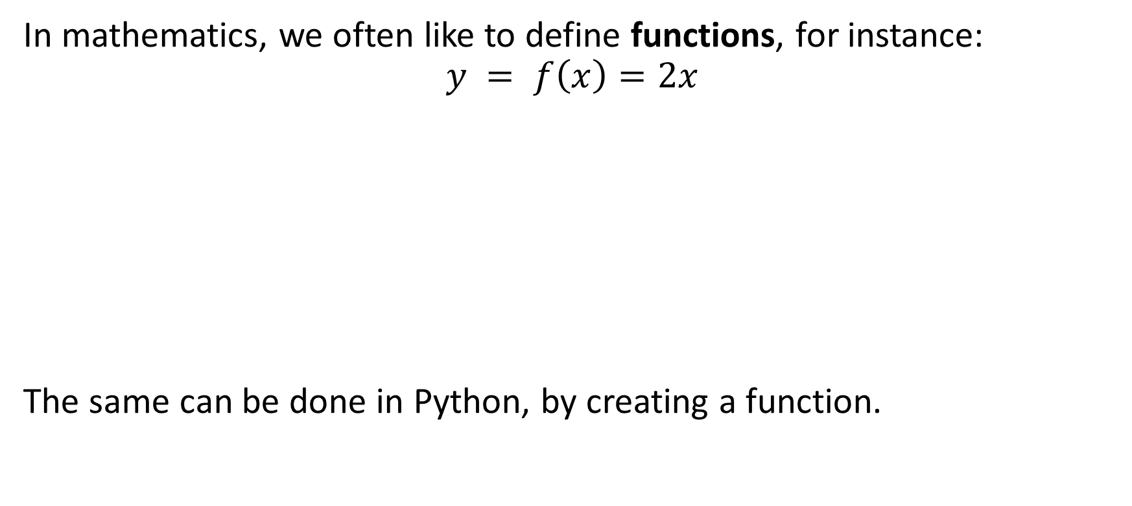
Function objects
In mathematics, we often like to define functions, for instance:
$$y = f\left(x\right)=2x$$
The same can be done in Python, by creating a function.
Input $$x$$
Input 𝑥
Goes through function $f$
$$f(x) = 2x$$
Goes through function 𝑓
𝑓(𝑥) = 2𝑥
Output $$y=f\left(x\right)$$
Output 𝑦=𝑓(𝑥)

Slide 38
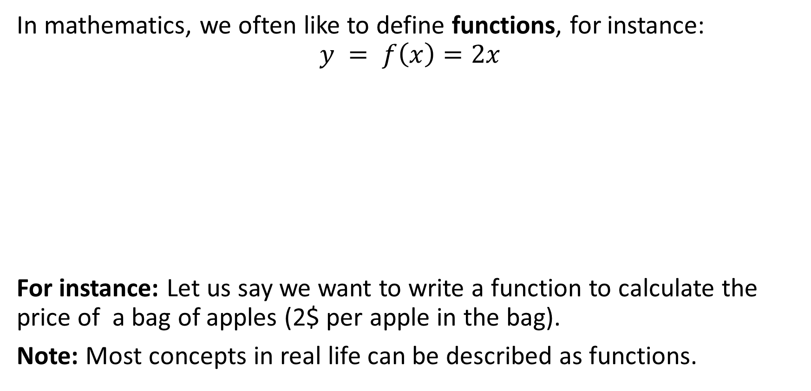
Function objects
In mathematics, we often like to define functions, for instance:
$$y = f\left(x\right)=2x$$
For instance: Let us say we want to write a function to calculate the price of a bag of apples (2$ per apple in the bag).
Note: Most concepts in real life can be described as functions.
Number of apples $$x$$
Number of apples 𝑥
Function $f$ (2$/apple)
$$y=f(x) = 2x$$
Function 𝑓 (2$/apple)
𝑦=𝑓(𝑥) = 2𝑥
Price for apples $$y$$
Price for apples 𝑦

Slide 39
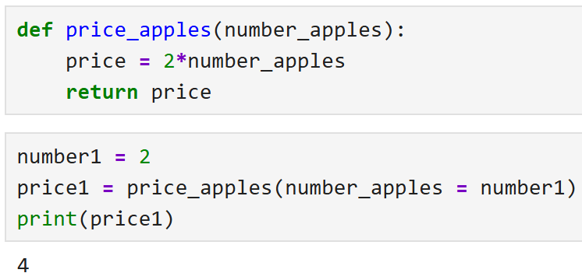
Function formatting in Python
Definition (Python functions):
A Python function is a block of reusable code which only runs when it is called.
You can pass data, known as parameters, arguments or input values, into a function (e.g., the value number_apples here).
A function can return data, as a result or output value (e.g., the value price here).

Slide 40
Function formatting in Python
Writing a function 101:
You can define a function, with a def statement.
After def, type the function’s name (appears in blue).
Between parentheses, after the function’s name, type arguments/parameters.
Note: Arguments/parameters would be values that the function needs to operate. In our example, it is not possible to compute the price for a bag of apples without knowing the number of apples in the bag.

Slide 41
Function formatting in Python
Writing a function 101:
Using the return keyword, type output values/results, that your function should give, if any.
Note: In general, the returned values are values of interest that we are aiming to compute with the given function. They are also values that could later be reused by some other functions. For instance, we could have a second function for printing a receipt, and it would need to know the price we just calculated.

Slide 42
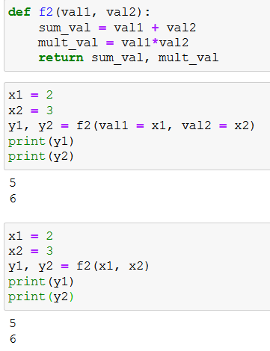
Function formatting in Python
Note 1: Your functions may have multiple inputs, as well as outputs, separated with commas.
Note 2: When calling a function, you can
Explicitly assign parameter, e.g. f2(val1=x1, val2=x2),
Rely on positional arguments, e.g. f2(x1, x2), where Python automatically assigns values in the order that they appear in the def statement.

Slide 43
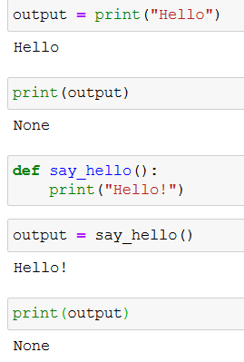
Function formatting in Python
Note 3: Your function may also not return anything (that is the case for the print() function!). It is equivalent to return None.

Slide 44
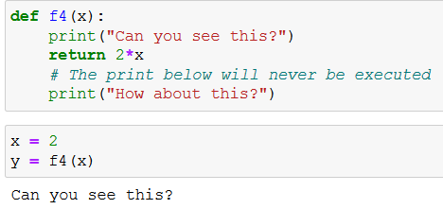
Function formatting in Python
Note 3: Your function may also not return anything (that is the case for the print() function!). It is equivalent to return None.
Note 4: In-between the def and return statement (if any), you may write lines of code to perform any number of additional or intermediate tasks.
Important, however, lines of code inside the function are indented with 4 spaces.

Slide 45
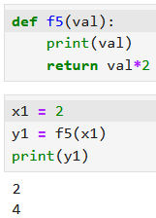
Returning vs. Printing
Note 5: Returning and printing are not the same thing!
Printing simply means “displaying the current value of something on screen”.
Returning means producing a specific value, deemed the final result of the function.
The value being returned can then be caught and stored in memory, which would not be the case if the return had been omitted.
These values might often by used by additional functions (e.g. price of apples, printing a receipt, etc.).

Slide 46
Function formatting in Python
Note 6: Once a return is reached and executed, the function closes. It will not execute anything else.
Any operations that happen after the return keyword triggers will simply not execute. Here, the second print does not show because the return stopped the function.

Slide 47
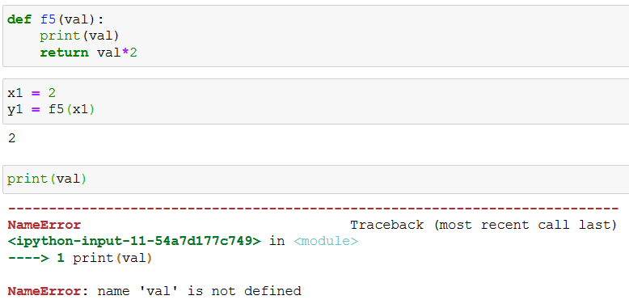
Variables in functions
Note 7: Variables defined inside the function are stored in memory while the function runs but are cleared/discarded once the end of the function is reached. If you need to access a variable defined inside a function, after the function has executed, then it needs to be explicitly returned.

Slide 48
Variables in functions and memory state
Computer memory state
Python script
Global variables
my_function = Function of some sort defined on line 1.
x1 = integer variable with value 10
z1 = integer with value 23
Function variables (for instance on line 7)
x = integer variable with value 10
y = integer variable with value 20
z = integer variable with value 23
1 def my_function(x):
2 y = 2*x
3 z = y + 3
4 return z
5
6 x1 = 10
7 z1 = my_function(x1)
8 print(z1)

Slide 49
Variables in functions and memory state
Computer memory state
Python script
Global variables
my_function = Function of some sort defined on line 1.
x1 = integer variable with value 10
z1 = integer with value 23
Function variables (for instance on line 7)
x = integer variable with value 10
y = integer variable with value 20
z = integer variable with value 23
1 def my_function(x):
2 y = 2*x
3 z = y + 3
4 return z
5
6 x1 = 10
7 z1 = my_function(x1)
8 print(z1)

Slide 50
Variables in functions and memory state
Computer memory state
Python script
Global variables
my_function = Function of some sort defined on line 1.
x1 = integer variable with value 10
z1 = integer with value 23
Function variables (for instance on line 7)
x = integer variable with value 10
y = integer variable with value 20
z = integer variable with value 23
1 def my_function(x):
2 y = 2*x
3 z = y + 3
4 return z
5
6 x1 = 10
7 z1 = my_function(x1)
8 print(z1)
IGNORED FOR NOW

Slide 51
Variables in functions and memory state
Computer memory state
Python script
Global variables
my_function = Function of some sort defined on line 1.
x1 = integer variable with value 10
z1 = integer with value 23
Function variables (for function called on line 7)
x = integer variable with value 10
y = integer variable with value 20
z = integer variable with value 23
1 def my_function(x):
2 y = 2*x
3 z = y + 3
4 return z
5
6 x1 = 10
7 z1 = my_function(x1)
8 print(z1)

Slide 52
Variables in functions and memory state
Computer memory state
Python script
Global variables
my_function = Function of some sort defined on line 1.
x1 = integer variable with value 10
z1 = integer with value 23
Function variables (for function called on line 7)
x = integer variable with value 10
y = integer variable with value 20
z = integer variable with value 23
1 def my_function(x):
2 y = 2*x
3 z = y + 3
4 return z
5
6 x1 = 10
7 z1 = my_function(x1)
8 print(z1)

Slide 53
Variables in functions and memory state
Computer memory state
Python script
Global variables
my_function = Function of some sort defined on line 1.
x1 = integer variable with value 10
z1 = integer with value 23
Function variables (for function called on line 7)
x = integer variable with value 10
y = integer variable with value 20
z = integer variable with value 23
1 def my_function(x):
2 y = 2*x
3 z = y + 3
4 return z
5
6 x1 = 10
7 z1 = my_function(x1)
8 print(z1)

Slide 54
Variables in functions
Computer memory state
Python script
Global variables
my_function = Function of some sort defined on line 1.
x1 = integer variable with value 10
z1 = integer with value 23
Function variables (for function called on line 7)
x = integer variable with value 10
y = integer variable with value 20
z = integer variable with value 23
1 def my_function(x):
2 y = 2*x
3 z = y + 3
4 return z
5
6 x1 = 10
7 z1 = my_function(x1)
8 print(z1)

Slide 55
Variables in functions and memory state
Computer memory state
Python script
Global variables
my_function = Function of some sort defined on line 1.
x1 = integer variable with value 10
z1 = integer with value 23
Function variables (for function called on line 7)
x = integer variable with value 10
y = integer variable with value 20
z = integer variable with value 23
1 def my_function(x):
2 y = 2*x
3 z = y + 3
4 return z
5
6 x1 = 10
7 z1 = my_function(x1)
8 print(z1)

Slide 56
Variables in functions and memory state
Computer memory state
Python script
Global variables
my_function = Function of some sort defined on line 1.
x1 = integer variable with value 10
z1 = integer with value 23
Function variables (for function called on line 7)
x = integer variable with value 10
y = integer variable with value 20
z = integer variable with value 23
1 def my_function(x):
2 y = 2*x
3 z = y + 3
4 return z
5
6 x1 = 10
7 z1 = my_function(x1)
8 print(z1)
Before ending the function, Python will clear all the variables related to this function to save space.

Slide 57
Variables in functions and memory state
Computer memory state
Python script
Global variables
my_function = Function of some sort defined on line 1.
x1 = integer variable with value 10
z1 = integer with value 23
Function variables (for instance on line 7)
x = integer variable with value 10
y = integer variable with value 20
z = integer variable with value 23
1 def my_function(x):
2 y = 2*x
3 z = y + 3
4 return z
5
6 x1 = 10
7 z1 = my_function(x1)
8 print(z1)

Slide 58
Variables in functions and memory state
Computer memory state
Python script
Global variables
my_function = Function of some sort defined on line 1.
x1 = integer variable with value 10
z1 = integer with value 23
Function variables (for instance on line 7)
x = integer variable with value 10
y = integer variable with value 20
z = integer variable with value 23
1 def my_function(x):
2 y = 2*x
3 z = y + 3
4 return z
5
6 x1 = 10
7 z1 = my_function(x1)
8 print(z1)

Slide 59
Variables in functions and memory state
Computer memory state
Python script
Global variables
my_function = Function of some sort defined on line 1.
x1 = integer variable with value 10
z1 = integer with value 23
Function variables (for instance on line 7)
x = integer variable with value 10
y = integer variable with value 20
z = integer variable with value 23
1 def my_function(x):
2 y = 2*x
3 z = y + 3
4 return z
5
6 x1 = 10
7 z1 = my_function(x1)
8 print(z1)
9 print(y) # No longer exists! Error!

Slide 60

Variables in functions and memory state
In other words…
What happens in Vegas,
Stays in Vegas.
the function
the function
(unless it is explicitly returned)

Slide 61
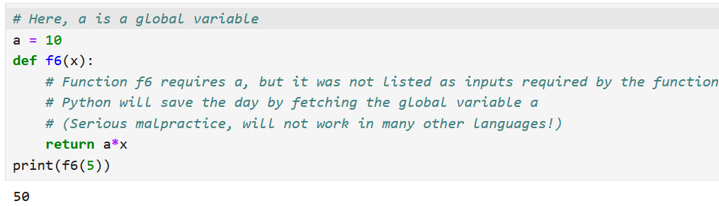
A note on global variables
Definition (global variables):
In Python, variables defined outside of any function are usually called global variables. They can be used anywhere, even in functions, BUT it is better practice to pass them as parameters to the function explicitly.

Slide 62
A note on global variables
Important note: Relying on global variables is considered malpractice!
If a function needs a variable, it should be listed as inputs.
Many other programming languages (e.g. C) will not allow for variables to be used in functions without being passed as inputs explicitly!

Slide 63

Matt’s Great advice
Matt’s Great Advice: Use functions to avoid repetitions of code
Find yourself copy-pasting blocks of code, and only changing a few values in this block of code?
Then, you probably need a function of some sort, which is called multiple times, but with different parameters.
Functions makes your coding modular, easier, and your code will look a lot more professional.

Slide 64
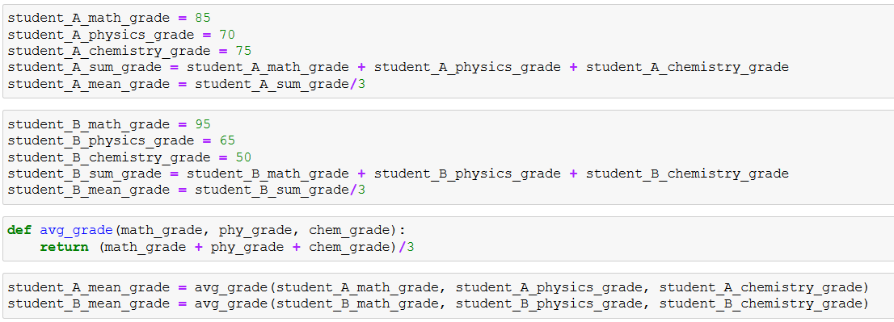
Matt’s Great advice: example

Slide 65
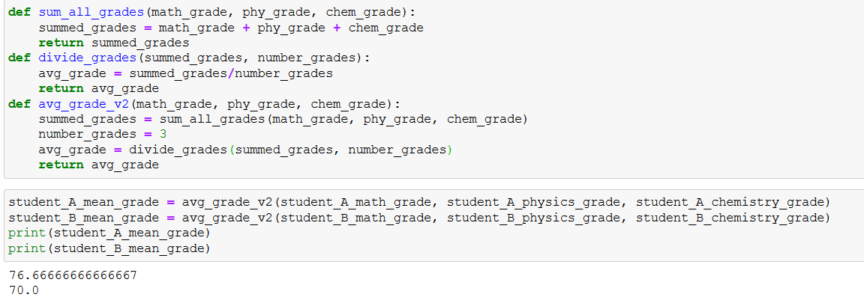
Subfunctions and calling them in other functions
Definition (Function modularity): You may find useful to define several functions and call them inside other functions. Again, this makes the code more modular, professional and readable.

Slide 66
Functional diagrams
If you have to design a function and/or several subfunctions, you might find it useful to draw a functional diagram.
See the one on the right, for the avg_grade() functions and its subfunctions.
A bit overkill right now, but….
When your code becomes heavier, breaking it down into well-chosen subfunctions, and keeping track of these functions will become essential.
F1: Sum all grades received as inputs
F2: Divide sum by number of grades
Return
F3 (main): avg_grade() function

Slide 67
Matt’s Great advice
Matt’s Great Advice: one main function to rule them all!
You may have defined several subfunctions and have designed a nice modular code.
Now is the time to define a main function that runs all of these functions at once. We often like to call it main().

Slide 68
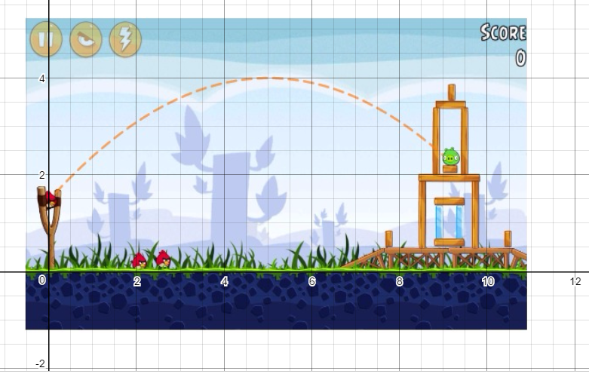
Activity 2: Ballistics of an angry bird
Let us practice these concepts with a second activity.
Check the notebook
Activity 2 - Ballistics of an angry bird.ipynb

Slide 69
Activity 2: Ballistics of an angry bird
Let us practice these concepts with a second activity.
Check the notebook
Activity 2 - Ballistics of an angry bird.ipynb
In this notebook, you will have to write a single function,
which computes the distance at which an angry bird will be landing,
depending on a given initial angle,
and an initial speed.

Slide 70
Conclusion (Chapter 3)
What are the None type and the pass keyword?
What is the Boolean type?
Boolean quiz for practice.
Advanced concepts on Booleans.
What are functions in Python and how to use them?
What are memory states in functions?

Slide 71
More activities for you to practice!
Activity 3: Distance to Point of Interest, flat earth version
In several video games, you can track the position of a point of interest and display the distance between the current player's position, defined as $(x_p, y_p)$; and the point of interest (PoI) located at the position $(x_t, y_t)$.
Write a function distance_to_poi() which receives 4 input parameters $(x_p, y_p, x_t, y_t)$and returns the distance $d$, in meters, between the player's position $(x_p, y_p)$and the PoI position $(x_t, y_t)$.

Slide 72
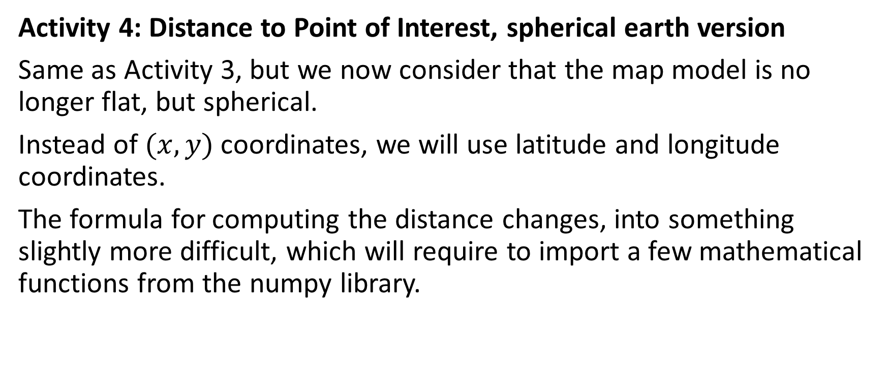
More activities for you to practice!
Activity 4: Distance to Point of Interest, spherical earth version
Same as Activity 3, but we now consider that the map model is no longer flat, but spherical.
Instead of $(x,y)$coordinates, we will use latitude and longitude coordinates.
The formula for computing the distance changes, into something slightly more difficult, which will require to import a few mathematical functions from the numpy library.

Slide 73
More activities for you to practice!
Activity 5: Is this triangle a right-angle triangle?
Consider a triangle with three lengths values a, b, and c (with c being the largest of all three values).
Write a function, which receives all three values and returns a Boolean, with value:
True, if the triangle is a right-angle triangle.
False otherwise.
The function should return False, if the values a, b and c passed are such that c is not the largest of all three values.
Do not use if statements just yet!

Slide 74
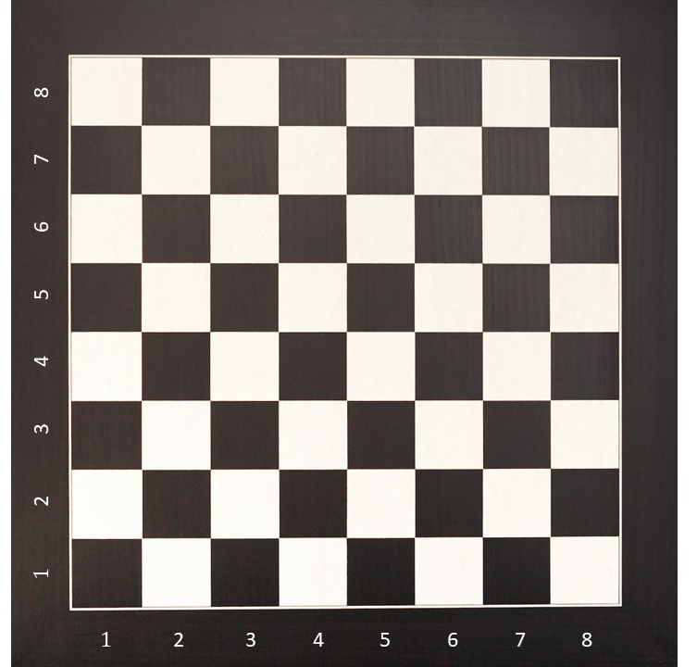
Activity 6: What color is the square?
Activity 6: What color is the square?
In this notebook, you will have to write several functions:
To collect user’s inputs on rows and columns indexes,
To check and print if the square is black or white.
Later on, you should assemble them in a nice main() function!
Do not use if statements just yet!

Slide 75
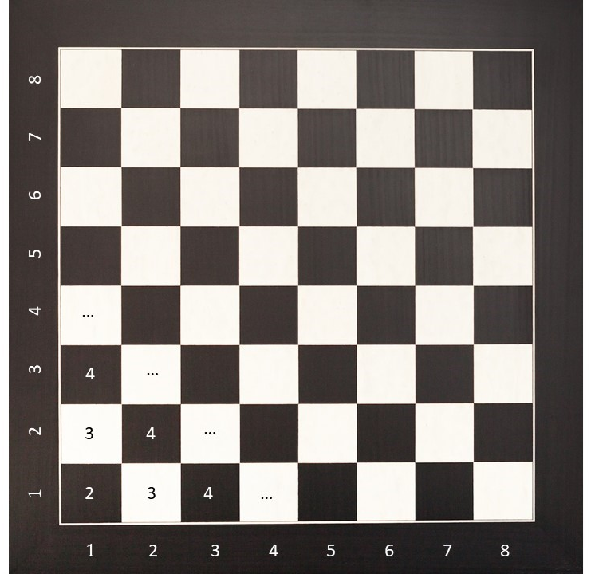
Activity 6: Hint
Activity 6: What color is the square?
Hint: what do I get if I sum the row and column indexes for all squares?
Do you recognize a pattern?

Slide 76
More activities for you to practice!
As usual, if needed, some extra Practice/Challenges are available! (Feel free to explore on your own!)
Activity 7: Guess the card game (used to be an in-class activity)
Same as Activity 1 (guess the number), but we now consider that the player must guess a card (color and values) instead of just a number.
You will have to write a few subfunctions and a main() function.
Do not use if statements just yet!

